Slide 1
JAVASCRIPT FRONT END
OBJECTIVES & SCHEDULE

Slide 2

OBJECTIVES
CHAPTER 1
Be able to code in JS as well as in Python
Be able to create elements in HTML using JS
Be able to interact with events
Be able to validate forms
Create an application to add, edit, remove items in a list
CHAPTER 2

Slide 3

SCHEDULE
3 WEEKS
THEORY / PRACTICE
1 WEEK
PROJECT
November
01
Holiday
1 WEEK
November
30
December
01

Slide 4

EVALUATION
50 %
FINAL EXAM
50 %
PROJECT

Slide 5
YOUR BEHAVIOR IN CLASS
ACTIVE =
CURIOUS
CREATIVE
EXPRESS YOURSELF
WORK IN TEAM

Slide 6
CHAPTER 1
PYTHON to JS
PART 1
WHAT IS JAVASCRIPT ?

Slide 7



EXPLORE
Open /exercice1 and run the HTML
Team of 2
15 MIN
Q1 - What does the script is doing ?
Q2 - Remove the script –run – what’s happen ?
Q3 – Between HTML and JS which one is start running first?
Q4 – Change the script to write THE BEST on the second paragraph
Q5 – Disable JavaScript on Chrome :
https://www.tutorialspoint.com/javascript/javascript_enabling.html
What ‘s happen ?

Slide 8
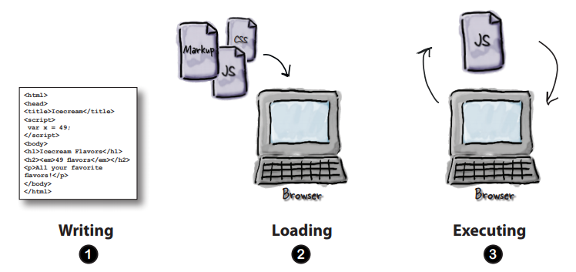
EXPLAIN
JS is the language understood by browsers
15 MIN

Slide 9

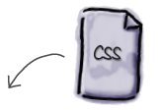


JS bring the behavior to your web application
CONTENT
STYLE
BEHAVIOR

Slide 10
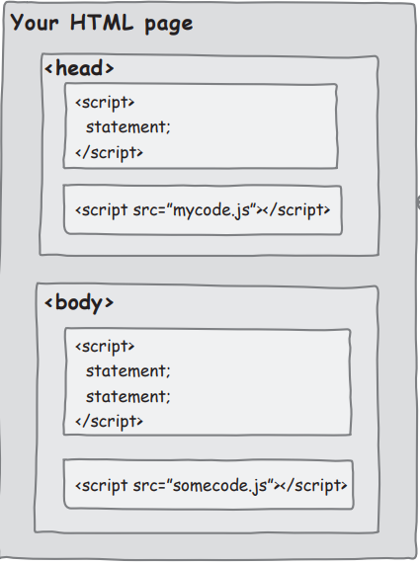
EXPLAIN
Like CSS : many places to write your JS code
You can write JS
inside the <head>
Or write JS
inside the <body>
Or write JS
In external file
(most common)

Slide 11
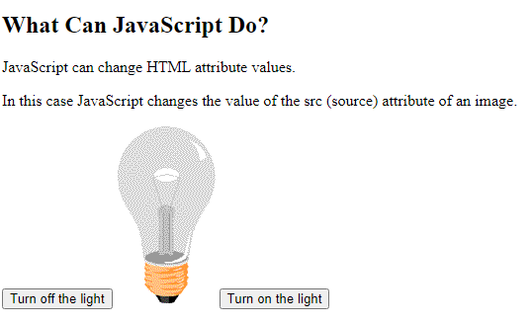
EXPLORE
Open /exercice2 and run the HTML
Team of 2
15 MIN
Q1 - Look at the code and find the way to turn on the light when we lick on button ON
Note: you have 2 images…

Slide 12
EXPLAIN
External JS advantages
It separates HTML and code
It makes HTML and JavaScript easier to read and maintain
Cached JavaScript files can speed up page loads
yourFile.js

Slide 13
EXPLORE
Open /exercice3
Team of 2
Q1 - Read following page https://www.w3schools.com/js/js_output.asp
Understand how to :
Write something in the console
Write something in the HTML document
Display an alert
15 MIN
Q2 - Edit the script to :
Write something in the console
Write something in the HTML document
Display an alert

Slide 14
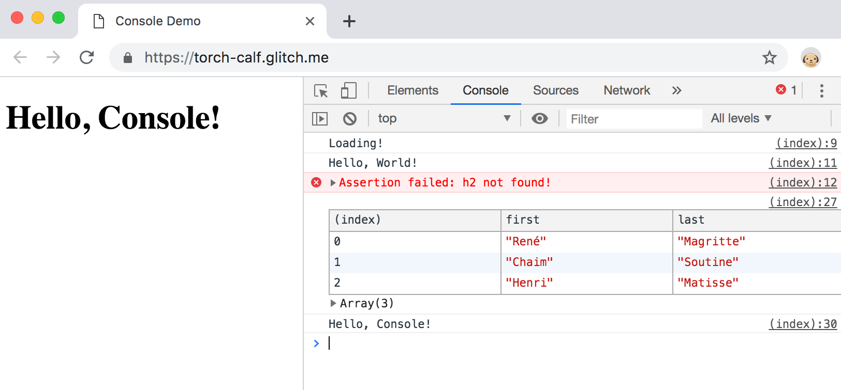
EXPLAIN
CORRECTION / DEMO
Can you access to the
Console ?

Slide 15

EXPLAIN
How to DEBUG ?
15 MIN
Using VS code
Using CHROME

Slide 16
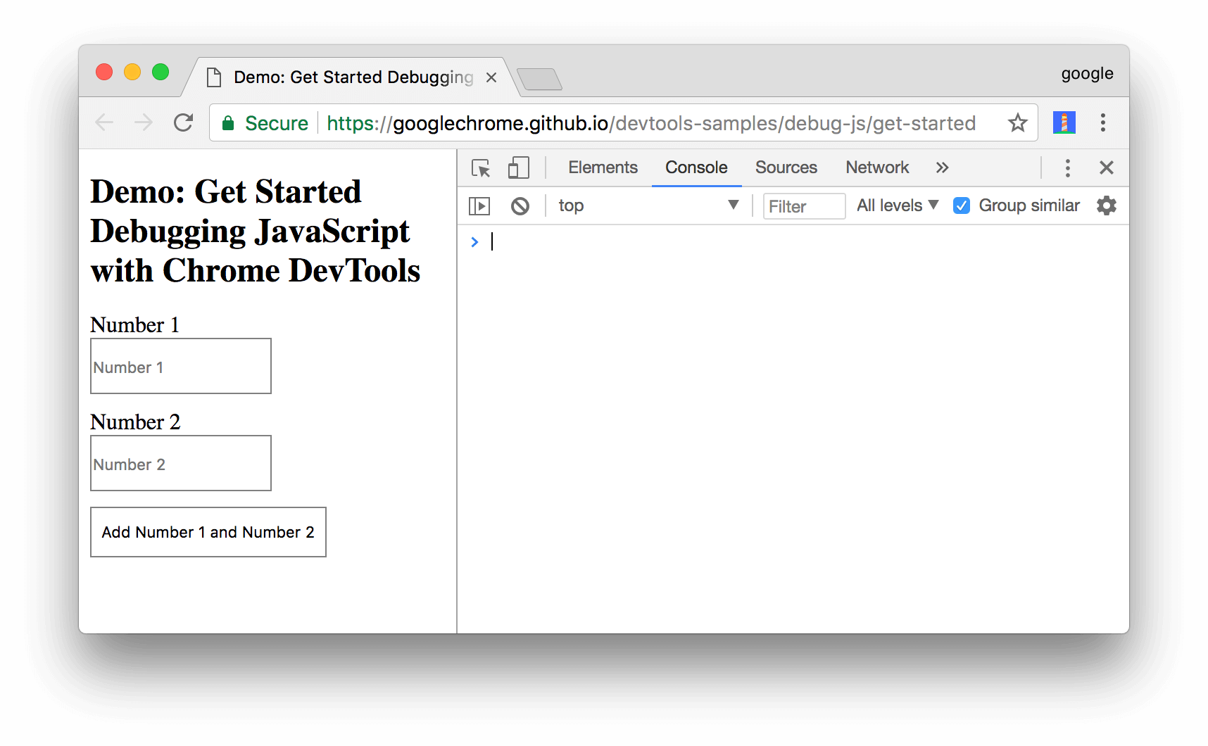
More info : https://developers.google.com/web/tools/chrome-devtools/javascript
Open DevTools by pressing Control+Shift+I

Slide 17
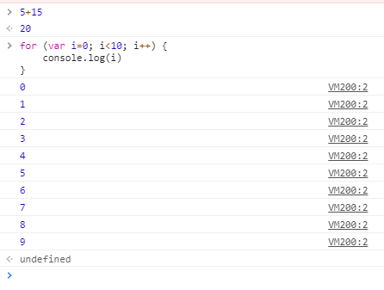
You can execute directly JS code in the chrome console !!!

Slide 18
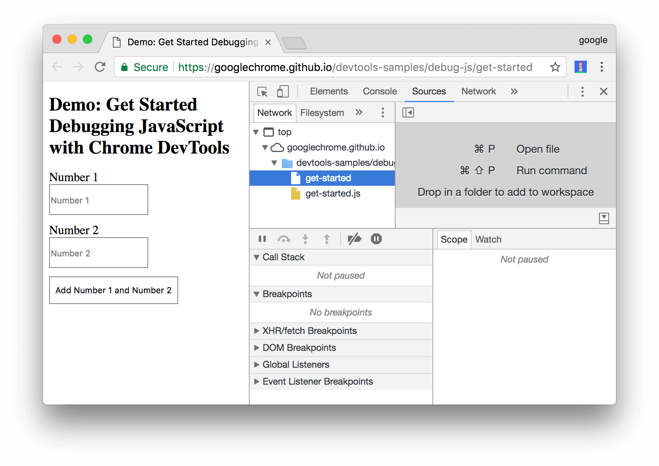
Click the Sources tab.

Slide 19
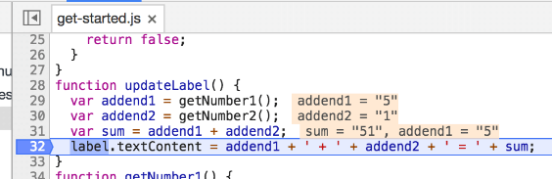
Add a breakpoint : click on the line you want the code to stop

Slide 20

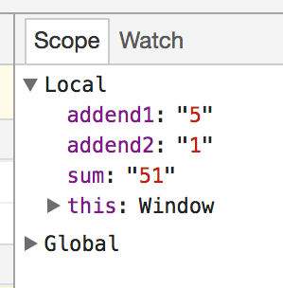
Use the debug navigation to go step by step or exit the debug mode
Check the variable of your code

Slide 21
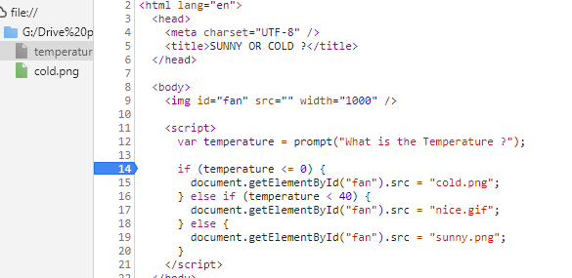
EXPLORE
Open /exercice4
Team of 2
1 – Execute the HTML in the browser
2– Add a break point at line 14
15 MIN
3– Go step by step in the IF / ELSE IF / ELSE condition
Try this for different temperatures

